Slide 1
CT055 Planned Maintenance Services Meet the Buyer Event
Thursday 27th February 14.30
Twickenham House,
59 - 71 Mount St, Ballymena BT43 6BP

Slide 2
Current Position
Elements of Planned Maintenance being tendered through an interim tender programme of:
Bathroom, Kitchen Rewires;
Bathroom only replacements;
Kitchen only replacements;
External cyclical maintenance;
Doors and windows replacements;
Individual roofing schemes.

Slide 3
CT055 Planned Maintenance Services Strategy/Workstreams
To deliver a Fit for Purpose Best in Class Customer Focused Maintenance Service:
Thirteen area based contract Lots;
Length of Contracts: Four Years with option to extend by up to three years or part thereof;
Bathroom, Kitchen Rewires;
Bathroom only replacements;
Kitchen only replacements;
Doors and windows replacements or part thereof;
Electrical rewiring;
Asbestos.
Roofing Schemes, EWI not part of contract.
NEC 4 TSC Utilising M3 NHMF 6.3 (NIHE) Schedule of Rates and Specification.

Slide 4
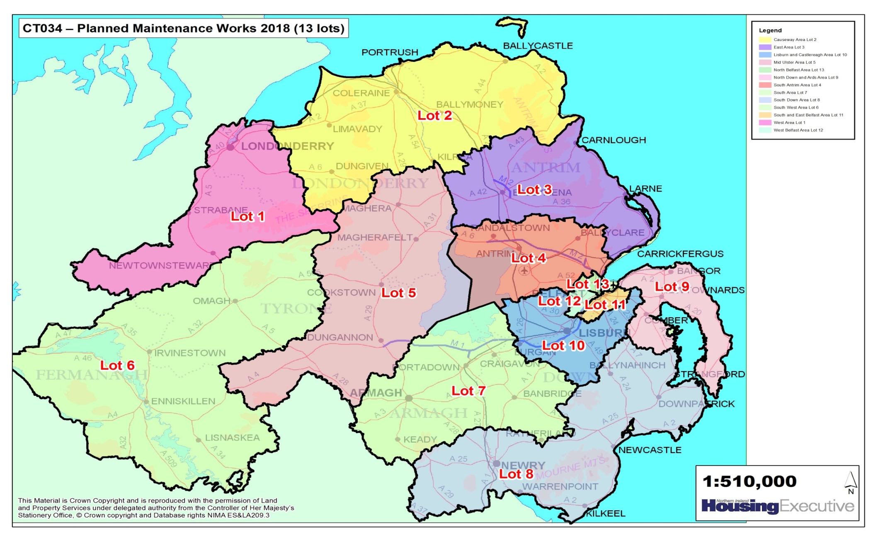
Lot Contract Area Map
CTO55 Planned Maintenance Contract Lot 1 - 13

Slide 5
Lot Contract Value
13 new Lot Contracts align with the geographical area offices;
Contracts start 1st April 2021
Contract Value approx:
£ 235,419,747 over 4 years
£454,089,509 over 7 years
Indicative values, workflow may increase depending on funding availability and contractor capacity
Based on:
Seven Year Programme for BKRs, Kitchen Only, Bathroom Only and Windows and Doors.
Costs are based on historical regional benchmarking data for these workstreams.
Includes a 2% allowance for Asbestos Removal & an Inflationary uplift of 3% for each year after year 2.
The actual value for each Lot shall be subject to funding for the planned maintenance. No guarantee to the value – non exclusive contracts.

Slide 6
Lot Contract Value
 |  | YEAR 1 | YEAR 2 | YEAR 3 | YEAR 4 | Yr 1-4 |  | YEAR 5 | YEAR 6 | YEAR 7 | Yr 1-7
 |  | 2021/22 | 2022/23 | 2023/24 | 2024/25 | Total Costs |  | 2025/26 | 2026/27 | 2027/28 | Total Costs
Region | Area | £ | £ | £ | £ | £ |  | £ | $ | £ | £
BELFAST | LISBURN AND CASTLEREAGH AREA | 2,799,576 | 3,125,652 | 3,458,750 | 3,696,200 | 13,080,177 |  | 3,928,956 | 4,161,867 | 4,430,037 | 25,601,037
 | NORTH BELFAST AREA | 2,698,488 | 3,014,118 | 3,333,970 | 3,561,485 | 12,608,060 |  | 3,784,584 | 4,012,377 | 4,272,338 | 24,677,358
 | SOUTH AND EAST BELFAST AREA | 5,785,170 | 6,456,228 | 7,143,127 | 7,644,256 | 27,028,781 |  | 8,115,775 | 8,599,211 | 9,156,347 | 52,900,115
 | WEST BELFAST AREA | 5,142,582 | 5,743,278 | 6,352,130 | 6,793,897 | 24,031,887 |  | 7,217,936 | 7,644,581 | 8,137,155 | 47,031,559
NORTH | CAUSEWAY AREA | 4,188,066 | 4,675,050 | 5,172,356 | 5,530,472 | 19,565,944 |  | 5,640,610 | 5,952,504 | 6,333,554 | 37,492,612
 | MID AND EAST ANTRIM AREA | 3,858,948 | 4,312,476 | 4,770,446 | 5,099,562 | 18,041,432 |  | 5,187,007 | 5,472,645 | 5,822,976 | 34,524,061
 | SOUTH ANTRIM AREA | 4,177,392 | 4,658,730 | 5,158,942 | 5,516,288 | 19,511,351 |  | 5,611,149 | 5,924,777 | 6,308,305 | 37,355,582
 | WEST AREA | 5,018,040 | 5,596,074 | 6,140,030 | 6,621,704 | 23,375,848 |  | 6,788,767 | 7,171,358 | 7,633,377 | 44,969,350
SOUTH | MID ULSTER AREA | 2,369,532 | 2,638,026 | 2,924,197 | 3,123,256 | 11,055,010 |  | 3,181,400 | 3,358,380 | 3,573,867 | 21,168,657
 | NORTH DOWN AND ARDS AREA | 3,783,000 | 4,226,766 | 4,676,111 | 5,004,057 | 17,689,934 |  | 5,067,073 | 5,365,426 | 5,692,205 | 33,814,639
 | SOUTH AREA | 4,765,878 | 5,323,194 | 5,887,500 | 6,297,361 | 22,273,933 |  | 6,406,461 | 6,759,757 | 7,195,160 | 42,635,311
 | SOUTH DOWN AREA | 3,530,148 | 4,026,960 | 4,452,293 | 4,765,055 | 16,774,455 |  | 4,823,013 | 5,089,023 | 5,421,591 | 32,108,083
 | SOUTH WEST AREA | 2,221,818 | 2,482,590 | 2,741,454 | 2,937,071 | 10,382,932 |  | 2,963,934 | 3,131,802 | 3,332,477 | 19,811,145
 |  | Year 1 | Year 2 | Year 3 | Year 4 |  |  | Year 5 | Year 6 | Year 7
 |  | 50,338,638 | 56,279,142 | 62,211,304 | 66,590,662 | 235,419,747 |  | 68,716,664 | 72,643,707 | 77,309,391 | 454,089,509

Slide 7
Procurement Process
2nd Bidders day, first held on 16th September 2020 with CEFNI & FMB;
Competition will be carried out in accordance with Regulation 27 (the Open Procedure) as set out in the Public Contract Regulations 2015;
Tender issued on EtendersNI by: 31 March 2020;
Tender closing 15th May 2020;
Clarifications Closes 6th May 2020.

Slide 8
Procurement Process
Evaluation 18th May to mid October:
Evaluation of Selection, Quality & Cost submissions commence concurrently, with different panels;
Board Approval 28th October 2020;
Issue Standstill Letters w/c 2nd November 2020.
Contract Start date: 1st December 2020 for physical on site from 1st April 2021

Slide 9
Procurement Strategy
Limited to bidding for a maximum of 4 Lots;
Win 1 Lot, provided exceeds Category Notation Value requested in Selection Questionnaire;
Lots shall be awarded in an award sequence detailed in the ITT document;
In the event that there are some unallocated Lots once all tenderers have been allocated 1 Lot after the award sequence has been completed, the Contracting Authority reserves the right to re-run the award sequence and award a maximum of 2.

Slide 10
Selection Criteria
Relevant experience – 3 contracts within the last 7 years of similar scale and scope;
Category value equal to or greater than the lot value;
Insurances – Public Liability £10m, Professional Indemnity £1m, Employers Liability £10m;
Mandatory requirements including but not limited to Buildsafe, SSIP and other requirements as detailed within Selection Questionnaire document.

Slide 11
Selection Criteria
Please note: References for SQ1 Section D-01 Technical and/or professional ability will need to be submitted with the Tender Return on the Referee’s Letter Headed Paper and signed by the Referee. Failing to do so will result in the Tender being rejected as non compliant.

Slide 12
Award Criteria
Each Lot awarded to MEAT:
40% Price
Percentage Adjustment to M3NHF 6.3 Schedule of Rates
Specific Price List for BKRs
60 % Quality Method Statements, minimum threshold for each

Slide 13
Price List
Utilising M3 NHMF 6.3 (NIHE) Schedule of Rates and Specification
Bidders provide a Tendered Rate for Bathroom, Kitchen and Rewires;
Bidders provide an adjustment against SOR for Windows & Doors, Asbestos Removal and works in relation to BKRs, electrical rewires to remaining rooms;
Quantities and Values in Price List have been devised from the Programme of Work for the next 4 years and costed against regional benchmarking information retained by Housing Executive.

Slide 14
Social Value
Contractors Sustainability Report
Buy Social Requirements (KPI 1 – Report Monthly, Monitor Quarterly)
Apprentices
3 directly employed New Trade Apprenticeships per year/ per Contract Lot (KPI 2 – Report Monthly, Monitor Quarterly)
Community Sustainability Partnership KPI 3 – Report Monthly, Monitor Quarterly) Community based project to be agreed with NIHE, Contractor and Community Group

Slide 15
Contract Management - KPIs
KPI – No LSD applied
KPI 1 - Buy Social Requirements (Contractor’s Sustainability Report) | Pass/Fail
KPI 2 – Apprentices | Pass/Fail
KPI 3 – Community Sustainability Partnership | Pass/Fail
KPI 4 – Customer Satisfaction | Pass/Fail
Delay damages will be applied for Survey & Design Task Order and for Works Task Order where applicable

Slide 16
Task Order Process
Two stage process:
Survey and Design Task Order (Per Property)
Works Task Order (Per Property)

Slide 17
Market Engagement Feedback
Feedback from Contractors | NIHE Response
Greater Emphasis on quality | Tender Criteria: 60% Quality, 40% Price
Method Statements based on Housing Executive needs | Requirement will be clearly detailed in Description of the Service
Use adjusted mean average | Pilot placed “on hold” by CPD
Scoring Scheme needs more clarify | Reverting to 5 point scale
Not enough information provided for IT Requirement | Will be addressed in ITT

Slide 18
Market Engagement Feedback
Feedback from Contractors | NIHE Response
Limitation of Constructionline for evaluation | Mandated by NI Public Procurement Policy. Limit Lots to Category Value
Need to verify references | New process for submitting references as part of tender
Allow contractors to select Lots | Limit number of Lots to 4
Consider moving to BCIS | Rent uplifts linked to CPI

Slide 19
Market Engagement Feedback
Feedback from Contractors | NIHE Response
Increase rate for Design / allow to be priced separately | Survey and design is deemed to be included
Adjustment on specific workstream | SOR for Windows & Doors Specific PL for BKRs
Limit Z Clauses | NEC 4 Term Service (Main form) – Additional Conditions reviewed
Reduce number of KPIs | 4 KPI’s plus Delay Damages
Scheme delivery process – timelines for both parties | Currently reviewing
Consistency of management across Regions | Purpose of Strategic Core Group

Slide 20
Note
NIHE reserves the right to change the procurement strategy, process, timeline etc. at its discretion before tender is advertised

Slide 21
Questions
Please email:
martin.mclaughlin@nihe.gov.uk

